Slide 1
Find in a linked list?
first
last
7 •
4 •
3 •
8 NULL
Find 3 in the list
Find 6 in the list
O(n)
Is there a better way?
Binary search tree!

Slide 2
Tree (new ADT)
Terminology:
A tree is a collection of elements (nodes)
Each node may have 0 or more successors (called children)
How many does a list have?
Each node has exactly one predecessor (called the parent)
Except the starting node, called the root
Links from node to its successors are called branches
Nodes with same parent are siblings
Nodes with no children are called leaves

Slide 3
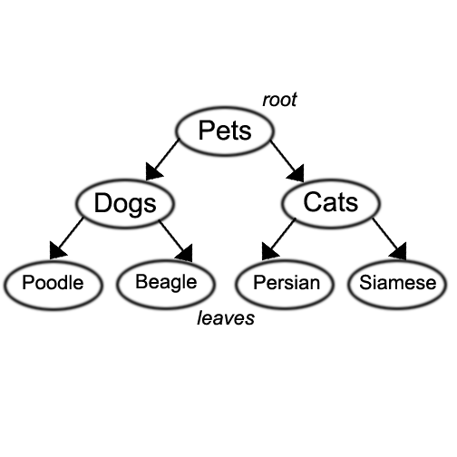
Tree
We also use words like ancestor and descendent
Pets is the parent of Dogs and Cats
Poodle and Beagle are the children of Dogs
Poodle, Beagle, Persian, and Siamese are descendents of Pets,
Pets is the ancestor of Poodle, Beagle, Persian, and Siamese

Slide 4
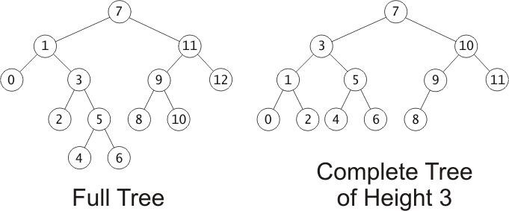
Tree Terminology
Subtree of a node:
A tree whose root is a child of that node
Depth of a node:
A measure of its distance from the root:
Depth of the root = 0
Depth of other nodes = 1 + depth of parent
1
2
3
4

Slide 5
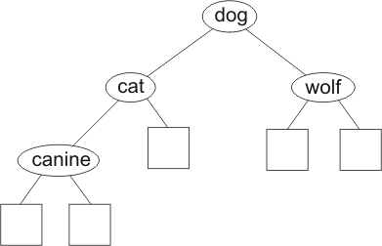
Binary Trees
Binary tree: a node has at most 2 nonempty subtrees
Set of nodes T is a binary tree if either of these is true:
T is empty
Root of T has two subtrees, both binary trees
(Notice that this is a recursive definition)
class Node {
string data;
node *left;
node *right;
};
This is a
binary tree

Slide 6
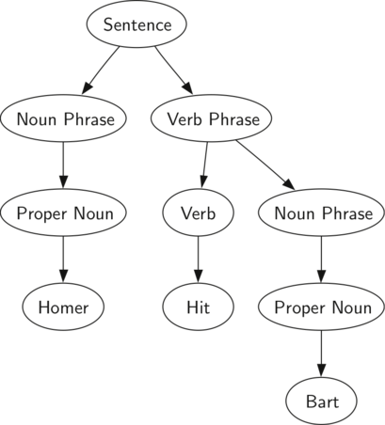
Example of binary tree:
Simple sentence parsing: used to model relationship between words in a sentence:
Used for topic determination
Learning tools
Language translation
Etc.

Slide 7
Fullness and Completeness (for binary tree):
Trees grow from the top down
New values inserted in new leaf nodes
In a full tree, every node has 0 or 2 non-null children
A complete tree of height h is filled up to depth h-1, and, at depth h, any unfilled nodes are on the right.

Slide 8
Huffman Coding
Huffman codes used to compress information
JPEGs (images) use Huffman as part of their compression process
Basic idea:
Store most frequently occurring info with a shorter representation than info that occurs less frequently.
E.g.,
Represent e with:010
Represent z with: 1100001010
Each file will be different, based on frequencies

Slide 9
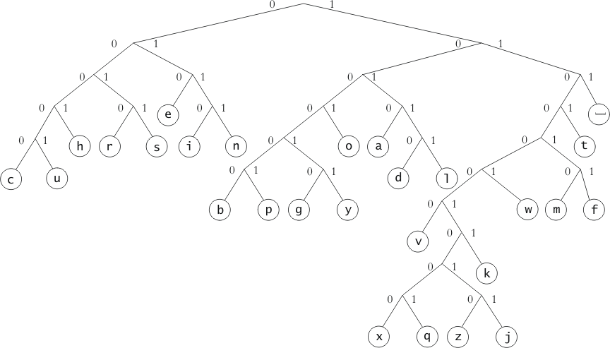
Examples: Huffman Binary Tree
Represents Huffman codes for characters appearing in a file or stream
Code may use different numbers of bits to encode different characters
Code for b = 100000
Code for w = 110001
Code for s = 0011
Code for e = 010

Slide 10
Node Class Definition for a Tree:
class NodeT {
int data;
NodeT *left;
NodeT *right;
NodeT *parent;
//optional:
int height; // height up from lowest descendent leaf
public:
NodeT(int x);
~NodeT();
void printNodeT();
};

Slide 11
Traversals of Binary Trees
Can walk the tree and visit all the nodes in the tree in order
This process is called tree traversal
Three kinds of binary tree traversal:
Preorder e.g., copying
Inorder – e.g., bst
Postorder –e.g., deleting or freeing nodes
order in which we visit the subtree root with respect to its children
Why do we worry about traversing in different orders?
Trees represent data – we may want to find or represent data in different ways depending on the data and the solution we are looking for

Slide 12
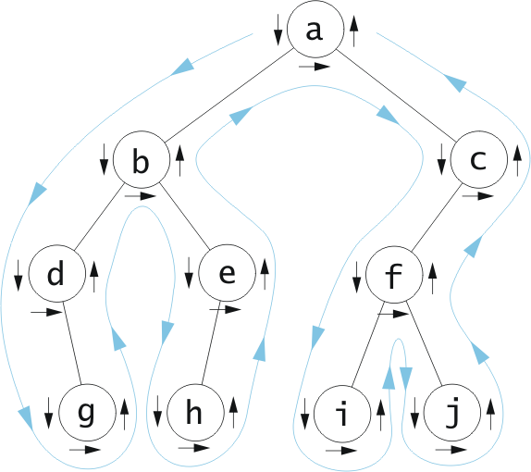
Tree Traversal: Preorder
Used for copying:
Visit root,
traverse left,
traverse right
Preorder:
a, b, d, g,e,h,
c, f, i, j

Slide 13
Tree Traversals: InOrder
Used for creating sorted list:
Traverse left (go till no more lefts),
visit root,
traverse right (always go to the left if there’s a left)
Inorder (left,
center, right)
d, g, b, h, e,
a, i, f, j, c

Slide 14
Tree Traversal: Postorder
Used for deleting:
Traverse left,
traverse right,
visit root
Postorder:
g, d, h, e, b,
i, j, f, c, a

Slide 15
Pre? In? Post?
36
16
48
15
21
40
11
23
44
41
PRE: 36 16 15 11 21 23 48 40 44 41
IN: 11 15 16 21 23 36 40 41 44 48
POST: 11 15 23 21 16 41 44 40 48 36

Slide 16
Given this code, what is printed out?
void BST::printTreeio(NodeT *n) { //recursive function
if (n == NULL) {
return;
}
else {
printTreeio(n->left);
n->printNode();
printTreeio(n->right);
}
}
36
16
48
15
21
40
11
23
44
41

Slide 17
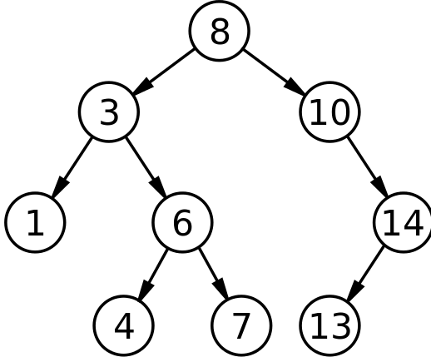
Binary Search Tree:
A tree in which the data in every left node is less than the data in its parent, and the data in the right node is greater than the data in its parent.
Inserting/Finding Data:
Data is inserted(found) by comparing the new data to the root
We move to either the left or the right child of the root depending on whether the data we’re looking for/inserting is less than or greater than the root.
The child, in essence, becomes the root of the subtree
the process continues until data is found or the child is null
if inserting, the data is inserted
If child is null and finding, data not in tree
8,3,6,10,7,14,1,13,4

Slide 18
Binary Search Tree
Inserting: 17, 13, 26,12, 15, 11, 14, 28, 33, 32
17
13
26
12
15
28
11
14
33
32

Slide 19
BST: Inserting pseudocode:
Bool InsertIt(int x): // iterative version
if root is NULL:
set root to new Node, with data x
else {
set n to be the root
while n is not NULL {
if x < n’s data
if n’s left child is NULL
set n’s left child to new Node with data x
set the new node’s parent to be n;
return True
otherwise set n to be n’s left child
else if x > n’s data
if n’s right child is NULL
set n’s right child to new Node with data x
set the new node’s parent to be n;
return True
otherwise set n to be n’s right child
else return false; //x already in tree
}
}
Bool InsertRec(int x, Node n): // recursive version
if n is NULL:
set root to new Node, with data x
else {
if x < n’s data
if n’s left child is NULL
set n’s left child to new Node with data x
set the new node’s parent to be n;
return True
otherwise call InsertRec with x and n’s left child
else if x > n’s data
if n’s right child is NULL
set n’s right child to new Node with data x
set the new node’s parent to be n;
return True
otherwise call InsertRec with x and n’s right child
else return false;
}
}

Slide 20
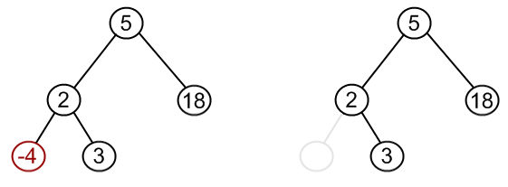
Removing: case 1
Search for node and then, if it’s in the tree, remove it.
3 cases:
Node to be removed has no children:
Just delete the node, and make the parent point to NULL (must keep track of parent)

Slide 21
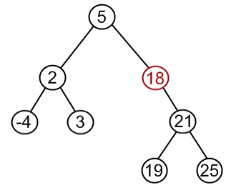
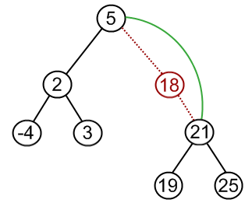
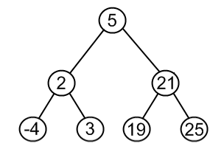
Removing: case 2
Node to remove has one child:
Parent points to node’s child
Delete node

Slide 22
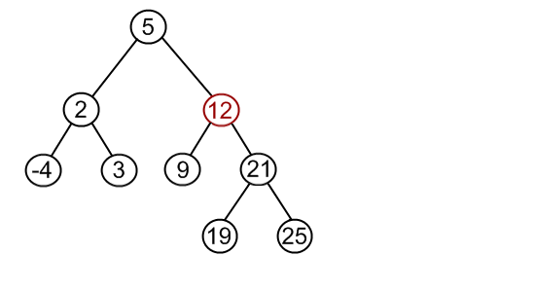
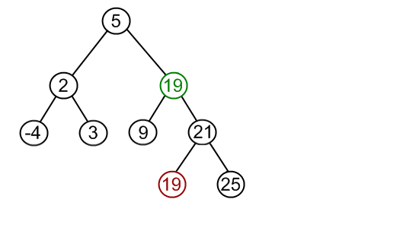
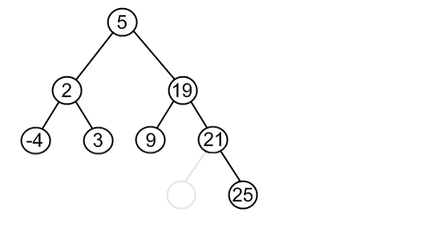
Removing: case 3
Node has 2 children.
Remember, we must maintain the BST properties when we remove a node
What if we want to remove 12 and we have the following tree:
7
10
7
10
7
10
Find the MINIMUM VALUE IN THE RIGHT SUBTREE
Replace the node with the value found
Remove the value from the right subtree
Is the tree still a binary search tree?
Notes:
Got here.

Slide 23
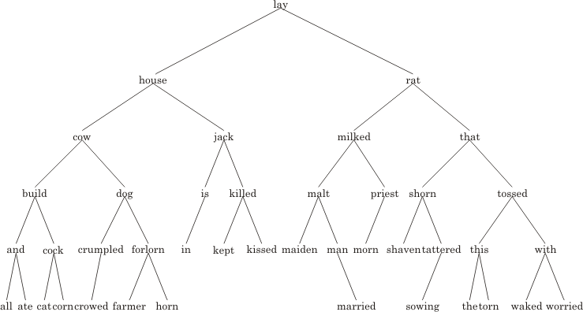
Remove rat from the tree

Slide 24
Remove rat from the tree
shaven

Slide 25
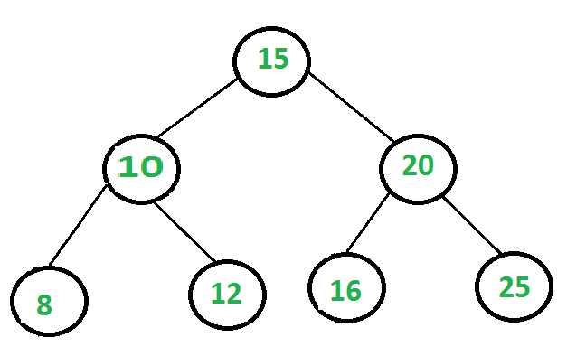
How many steps?
How many comparisons to find if 12 is in the tree?
How many nodes in the tree?
The number of nodes is n, and the number of levels is l, the number of nodes
given level l is between 2^{l-1} and 2^{l}

Slide 26
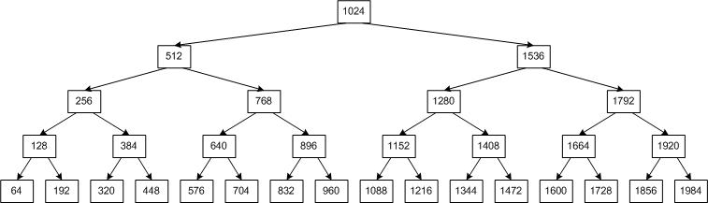
How ‘bout this one?
How many comparisons to find if 1600 is in the tree?
How many nodes in the tree?
The number of levels is 5, and the number of nodes n is between 2^{l-1} and 2^{l} – what’s n?

Slide 27
Analysis:
If a binary search tree has 2044 nodes, in the best case, how many layers does it have?
11
How many steps (at most) to find any node in the tree (best case)?
11
If a tree has 8100 nodes, at most it will take 12 steps to find anything in the tree (12 levels to the tree)
If a tree has 1048570 nodes, at most it will take 20 steps to find anything in the tree (20 levels)
If a tree has 2,147,483,640 nodes, it will take at most 31 steps to find/insert/remove anything in the tree.
WOW!
Can you see how, the more nodes, the bigger the savings for finding/inserting/deleting from a binary search tree?

Slide 28
Create a tree by inserting the following data
[1 | 2 | 4 | 7 | 13 | 24 | 29 | 32 | 36 | 42 | 55]
1
2
4
7
13
24
29
There are 11 nodes in this tree: How many comparisons to find 55 in this tree?
What did we just learn about binary search trees and efficiency?
32
36
42
55

Slide 29
BST Example
If there are between 2^{l-1}and 2^{l} (excluding 2^{l}) nodes, it will take at most l steps to find any node in the tree, which is O(log n)
At every comparison, we should eliminate half of the nodes necessary for future comparison
… if tree is balanced
Balanced: at any node, the height of the left subtree and the height of the right subtree differ at most by 1
How do we make sure a tree stays balanced (in a reasonable amount of time?
24
4
36
2
13
29
55
1
3
7
17
32
42
62

